Slide 1
Analyzing eDNA metabarcoding of mifish
By: Joshua Addo, Armani Alonzo, Qiayra Classen Randolph

Slide 2
Outline
Background
Methods
Results
Conclusion and Final Remarks
Bibliography

Slide 3
BACKGROUND
Environmental DNA (eDNA) analysis has emerged as a powerful and noninvasive method for detecting and monitoring fish species.
This approach relies on PCR amplification of environmental water samples (Yao et al., 2022).
MiFish primers are predominantly used due to their broad applicability in targeting and identifying a wide range of fish species.
The objective of our project was to analyze eDNA metabarcoding of fish, with a focus on evaluating diversity, assigning taxonomy, and conducting differential abundance testing.

Slide 4
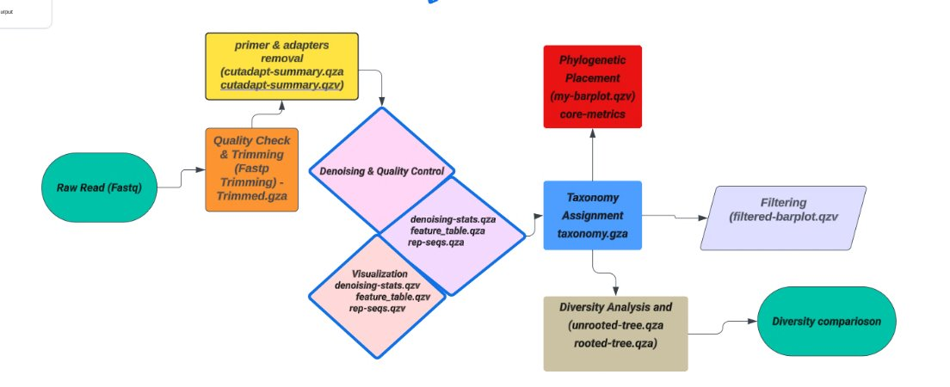
METHOD
Workflow Pipeline

Slide 5
METHOD
Data Collection: Raw sequencing reads (FASTQ, of two samples: Great Bay and Wells) were obtained via the RON platform using cd /tmp/gen711_project_data/eDNA-fqs/mifish/fastqs
Genomic Analysis Pipeline: The QIIME2 bioinformatics platform was employed for processing and analyzing preprocessed sequencing data.
The pipeline encompassed denoising, taxonomic classification, diversity analysis, and functional annotation of genomic features.

Slide 6
METHOD
Data Preprocessing:
Fastp software was utilized for quality control
Data was imported using qiime tools import
Trimming of raw sequencing reads, removing low-quality bases and adapter sequences using cutadapt trim-paired
We did this separately for the two samples.

Slide 7
METHOD
Denoising: The dada2 denoise-paired algorithm was employed for denoising paired-end sequencing data, generating high-quality amplicon sequence variants (ASVs).
Taxonomic Assignment : qiime feature-table merge-seqs and qiime feature-table merge
Taxonomic classification of ASVs was achieved using reference databases to assign taxonomic labels to the sequences using qiime feature-classifier classify-sklearn

Slide 8
METHOD
Diversity Analysis: Core metrics analysis was performed to assess alpha and beta diversity measures across samples using
phylogeny align-to-tree-mafft-fasttree and
diversity core-metrics-phylogenetic
qiime feature-table relative-frequency
qiime diversity alpha-group-significance

Slide 9
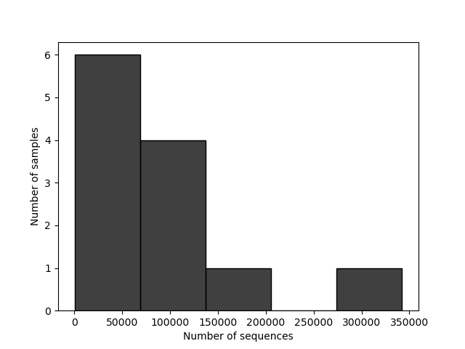
RESULTS
Data Preprocessing: quality control and trimming reads
Great Bay samples: Forward
Great Bay samples: Reverse

Slide 10
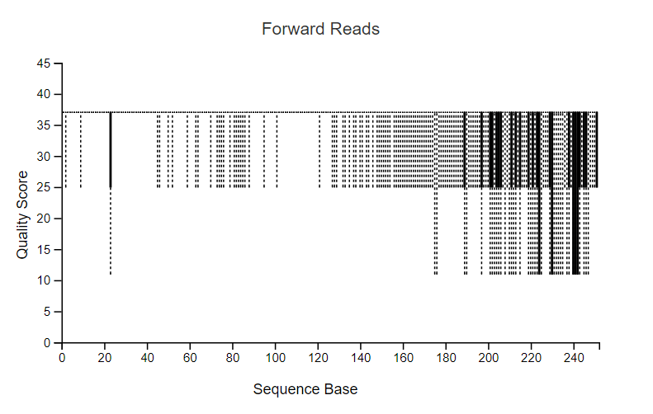
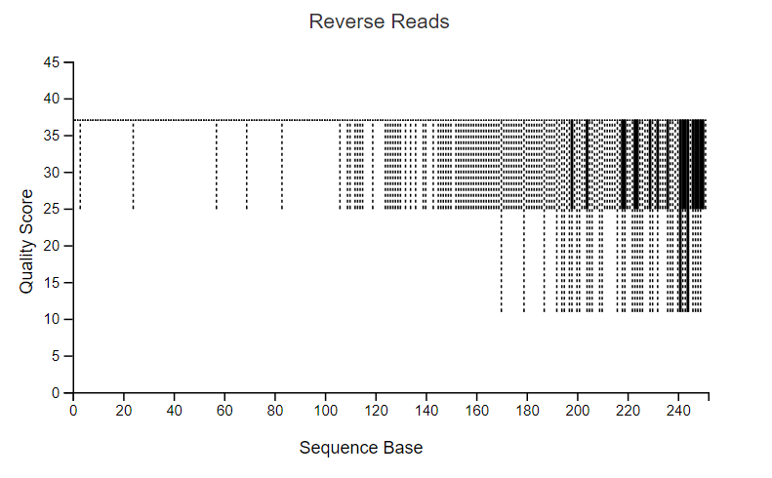
RESULTS
Data Preprocessing: quality control and trimming reads
Great Bay samples: Forward
Great Bay samples: Reverse

Slide 11
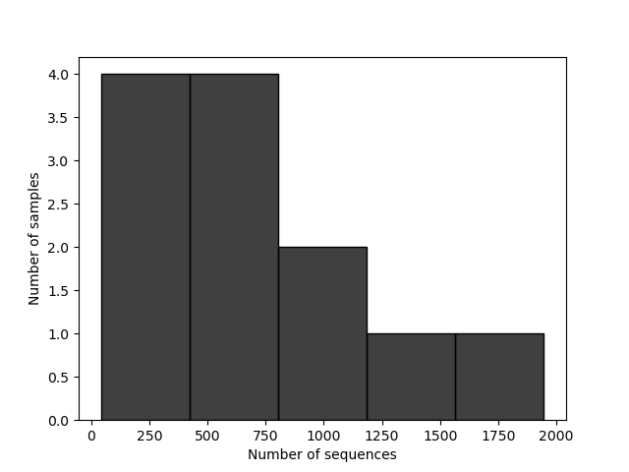
RESULTS
Data Preprocessing: quality control and trimming reads
Wells samples: Forward
Wells samples: Reverse

Slide 12
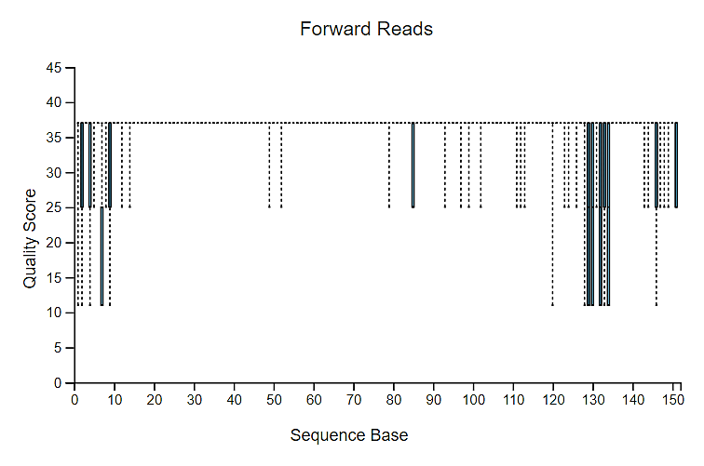
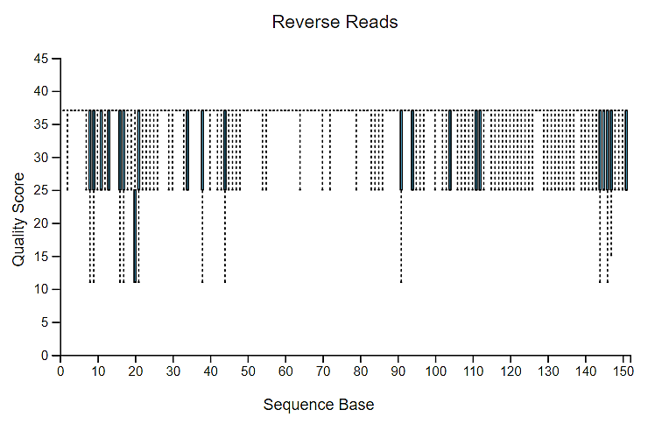
RESULTS
Data Preprocessing: quality control and trimming reads
Wells samples
Wells samples

Slide 13
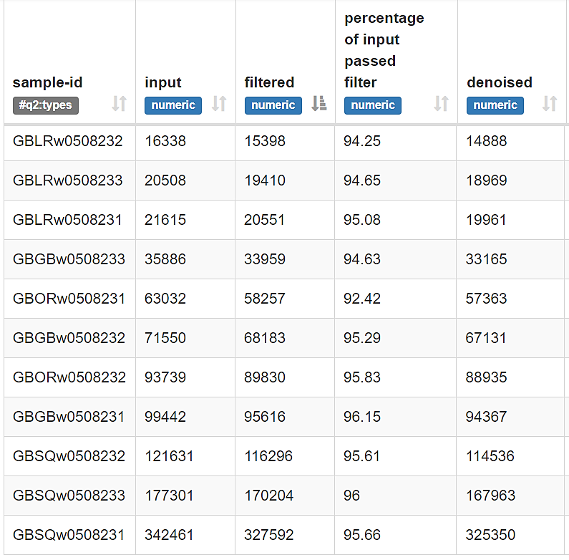
RESULTS
Denoising
Great Bay

Slide 14
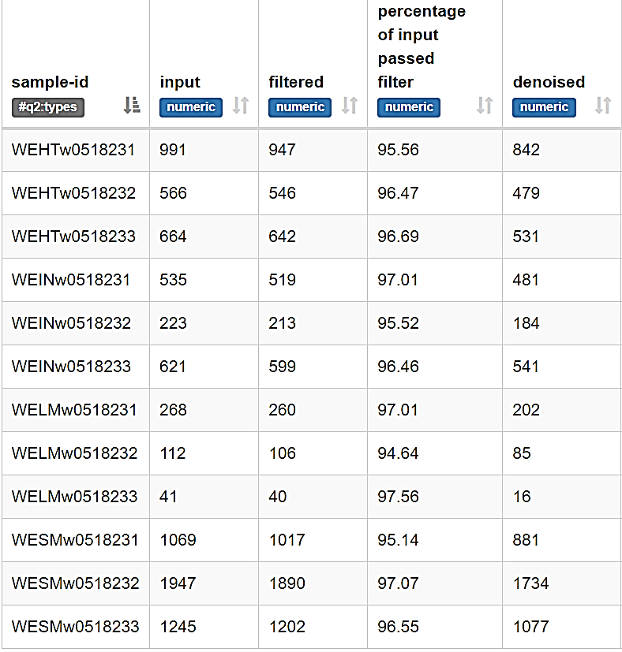
RESULTS
Denoising
Well samples

Slide 15
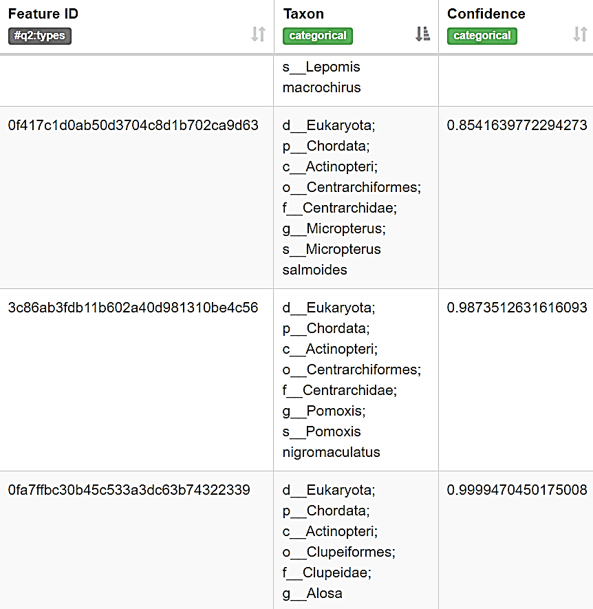
RESULTS
Taxonomic Assignment

Slide 16
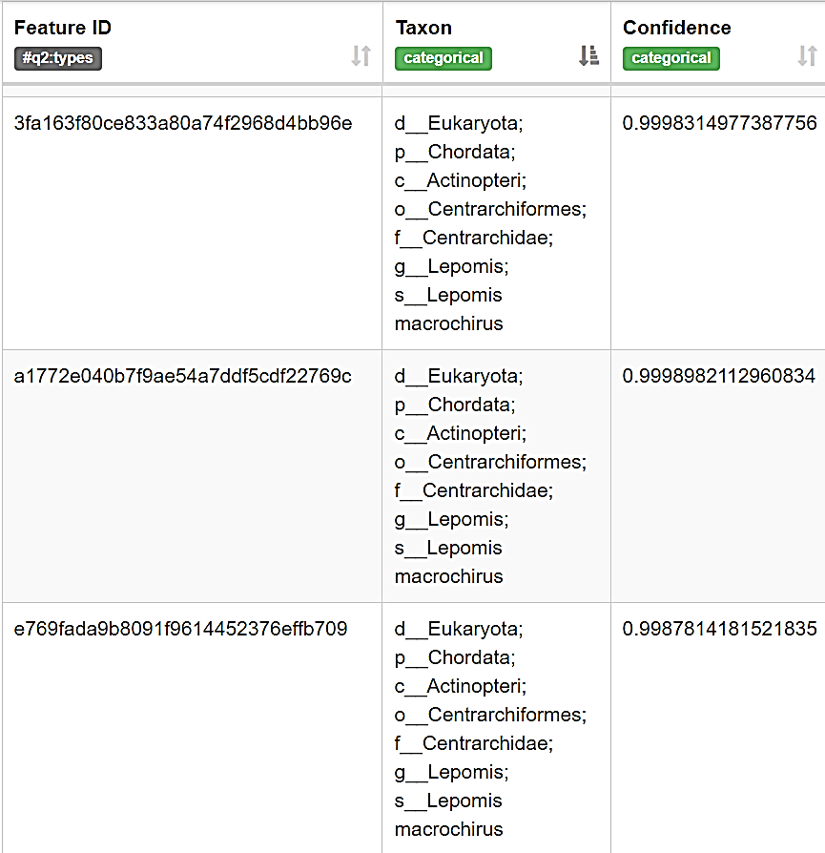
RESULTS
Taxonomic Assignment

Slide 17
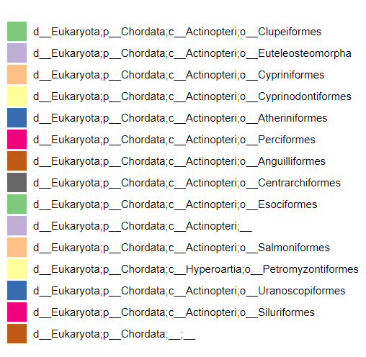
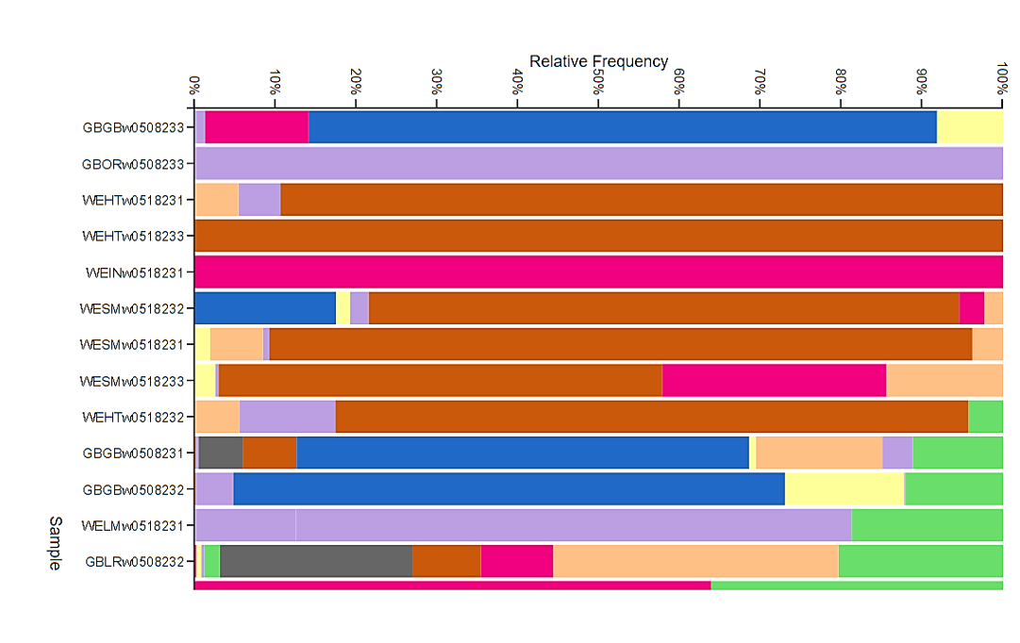
Taxonomic Classification

Slide 18
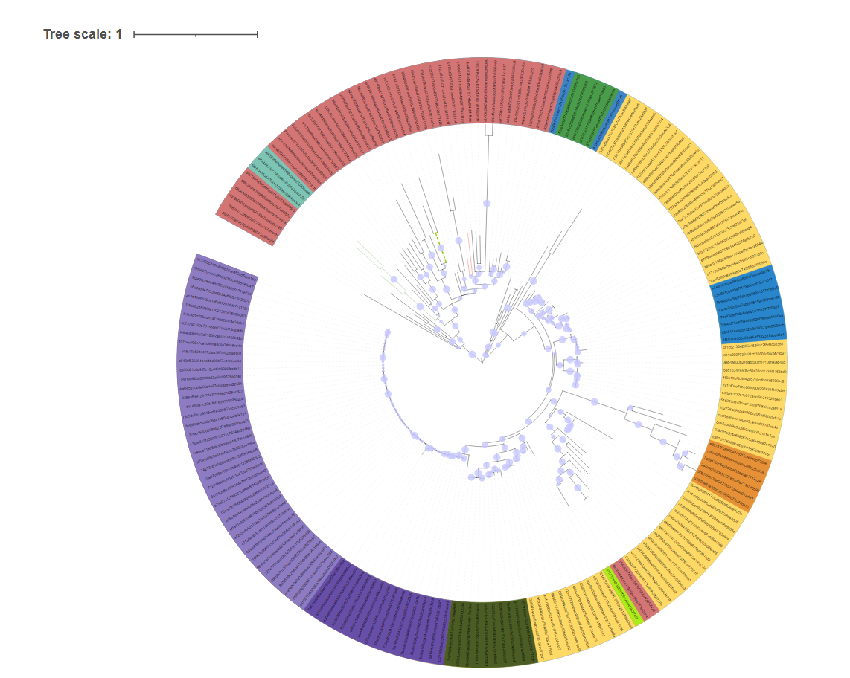
RESULTS: phylogenetic placement of ASVs
Phylogenetic Tree
Evolutionary relationships of the microbial taxa present in the community.

Slide 19
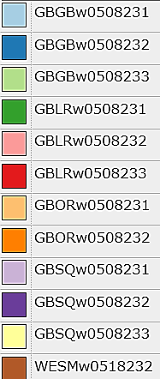
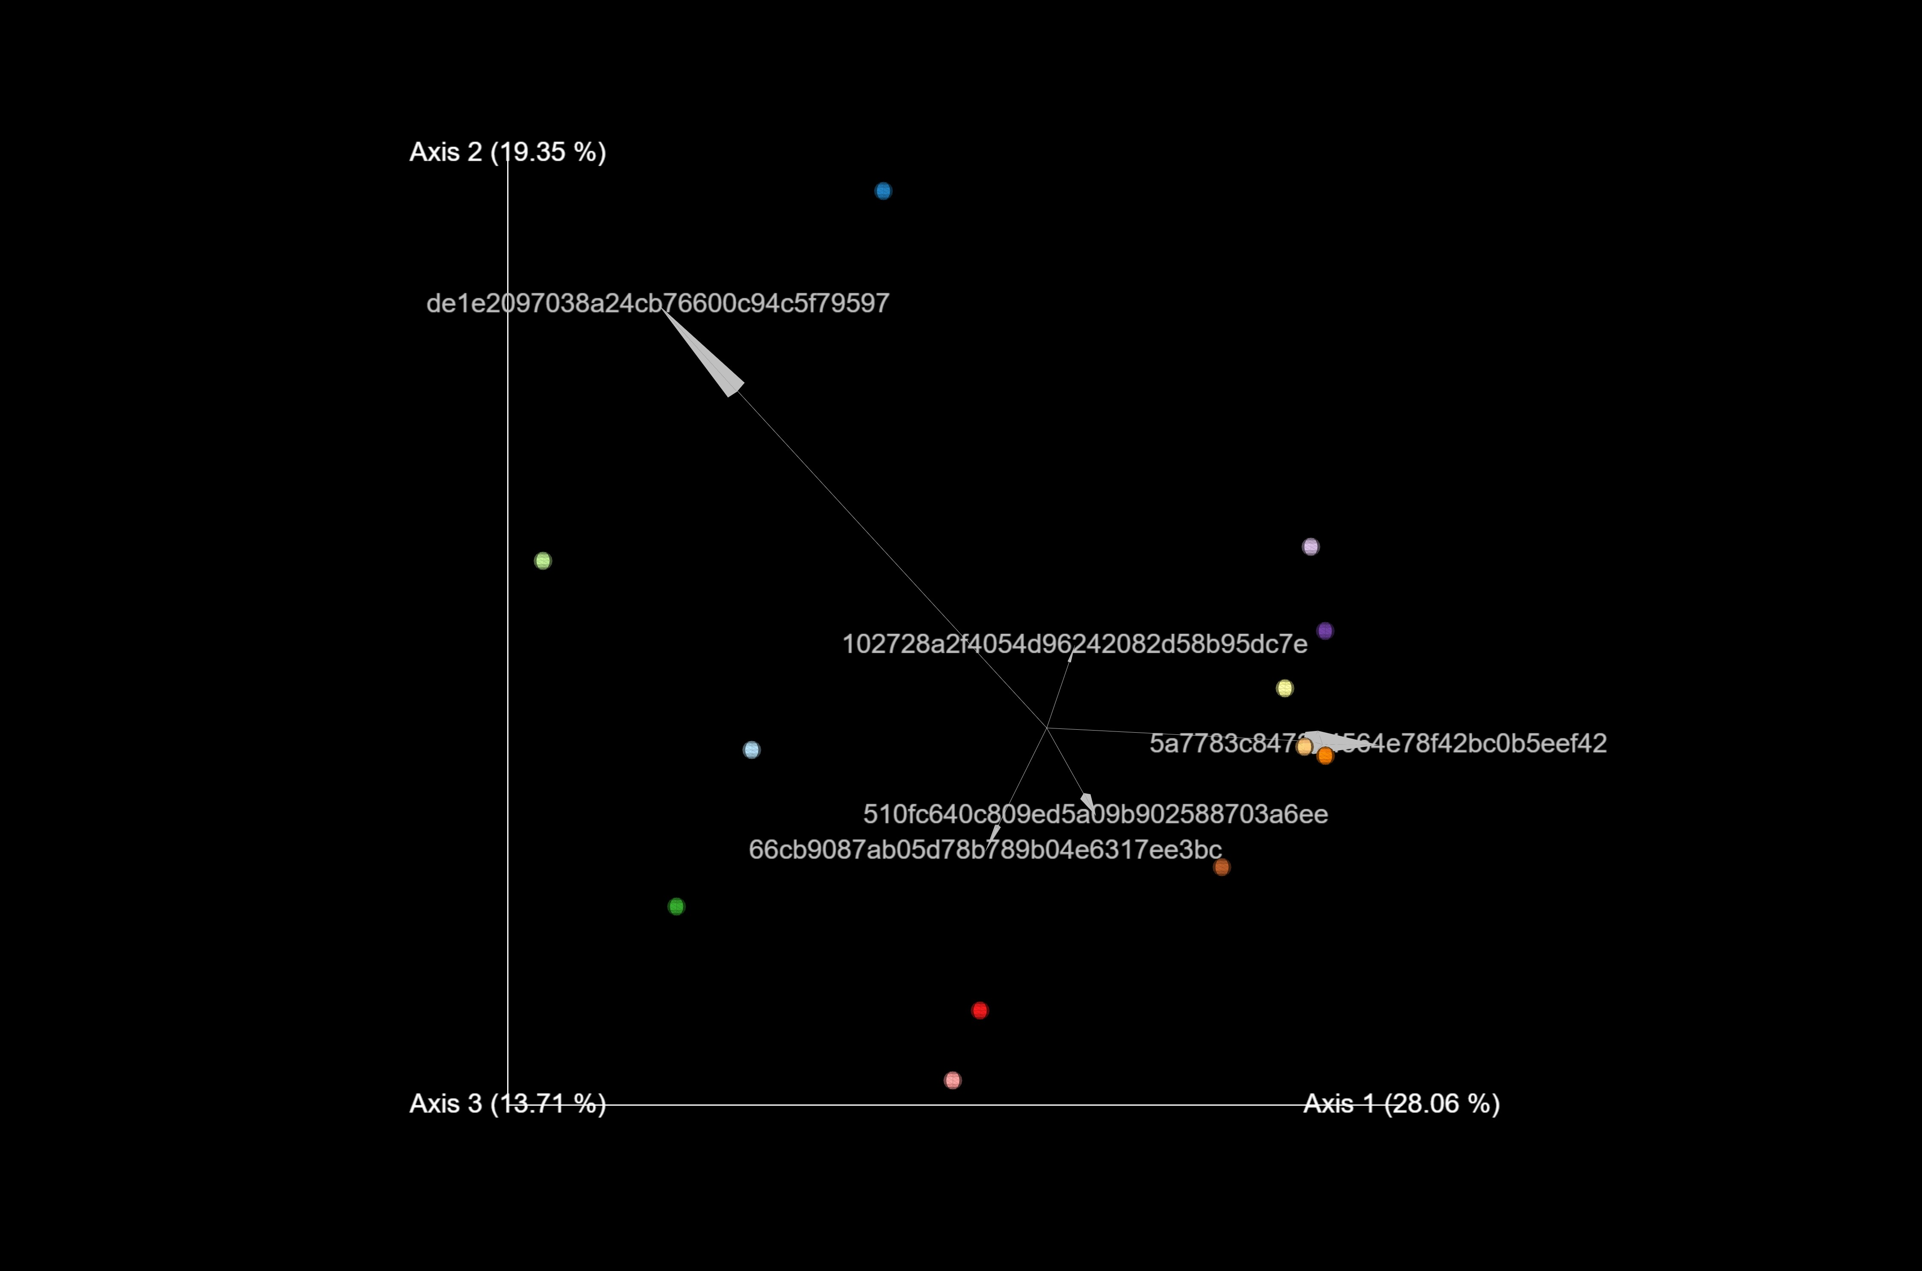
RESULTS:
Diversity Statistics: Beta diversity
Unweighted unifrac pcoa biplot
Community structure visualization: clustering, or outliers/dissimilarities

Slide 20
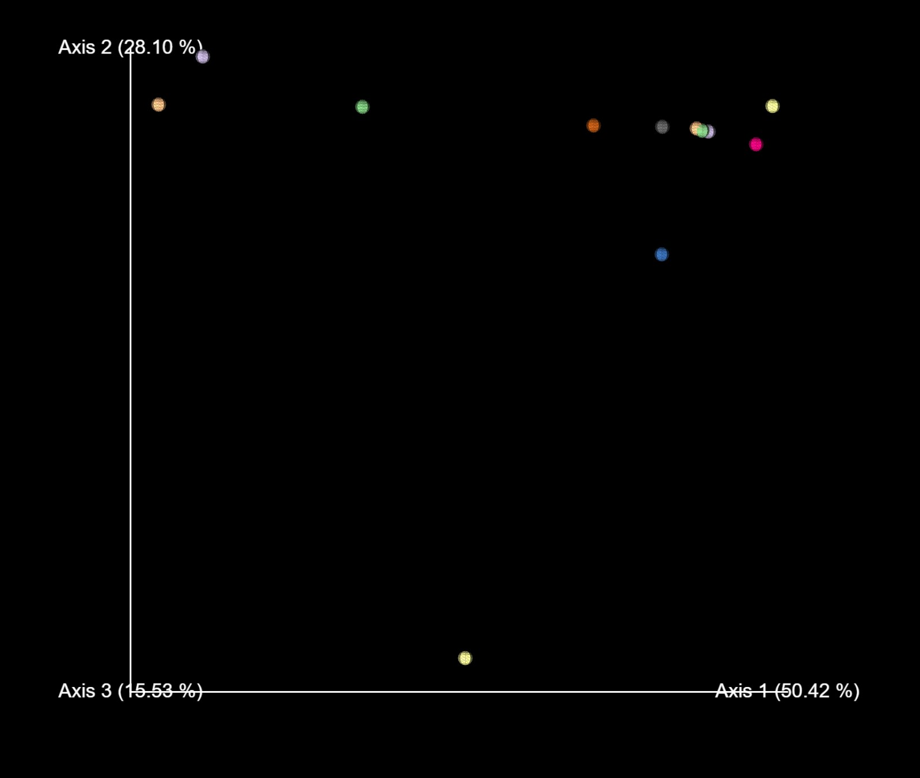
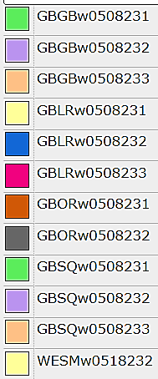
RESULTS:
Diversity Statistics: Beta diversity
Weighted UniFrac
more weight to abundant taxa

Slide 21
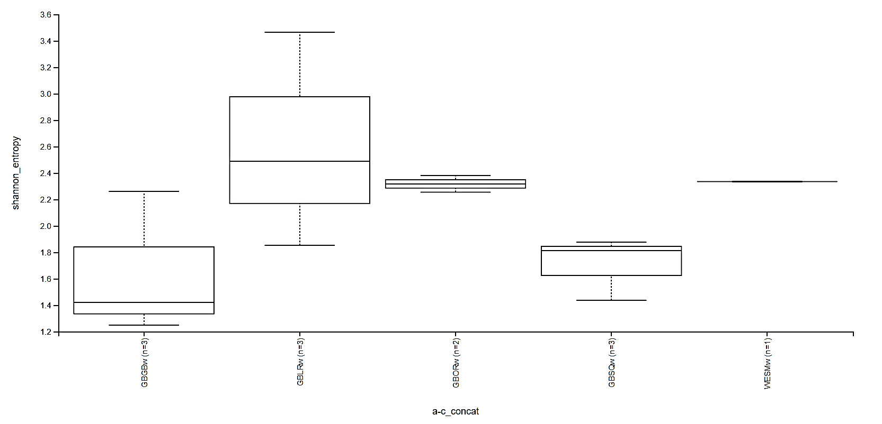
RESULTS : Diversity Statistics: Alpha diversity
Measures the richness and evenness of sample communities
trends, and variability

Slide 22
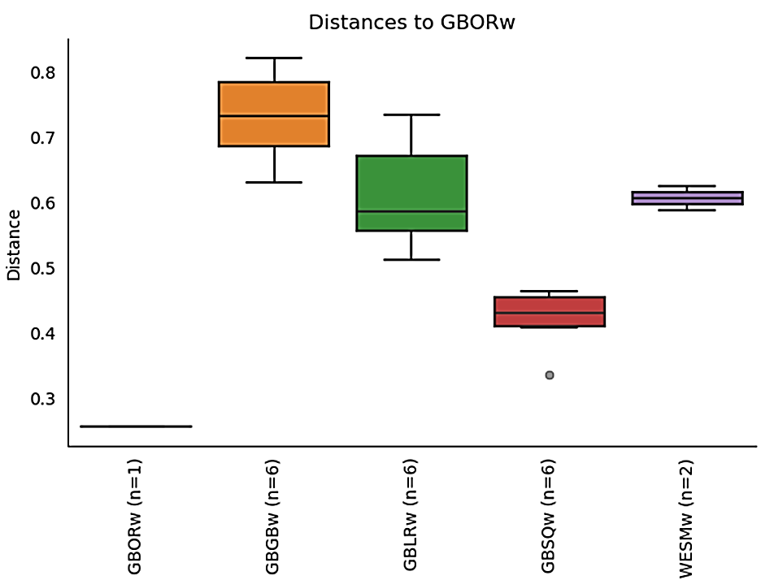
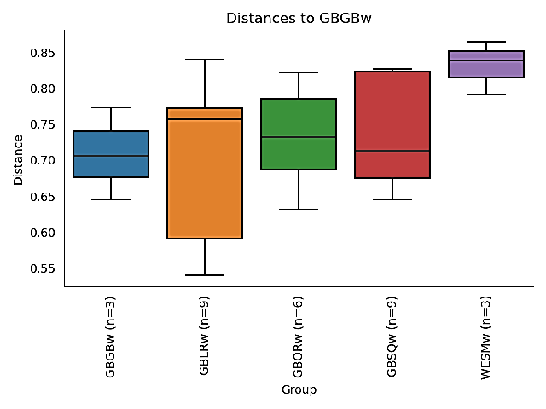
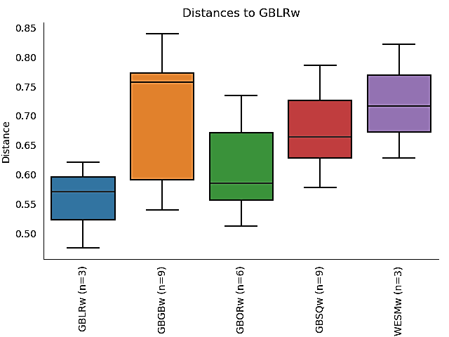
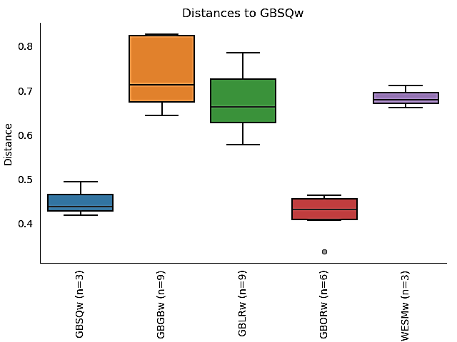
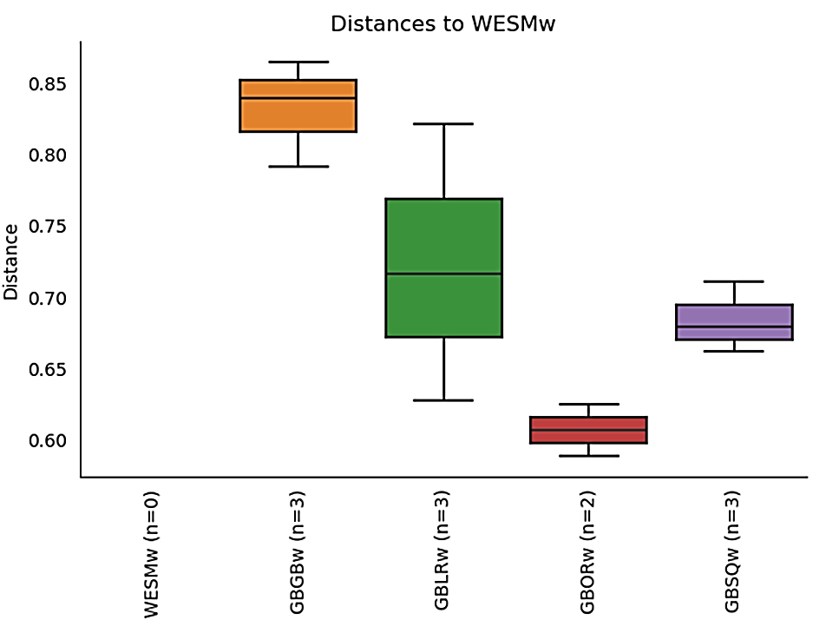
PERMANOVA: Group significance plots
Visual representation of group differences at p=0.001

Slide 23
CONCLUSION AND FINAL REMARKS
There were a lot of plot we could include because we don’t know how to interpret them.
We were not able to generate the species names for the samples.
We also run into various “code” troubles and Jeff and Kaleb helped us troubleshoot them.
All code used in this project and short explanations for each tool are found in our github repo: https://github.com/KwadwoLarbi/joshua-armani-qiayra_final-project

Slide 24
BIBLIOGRAPHY
Yao M, Zhang S, Lu Q, Chen X, Zhang SY, Kong Y, Zhao J. 2022. Fishing for fish environmental DNA: ecological applications, methodological considerations, surveying designs, and ways forward. Mol Ecol. 31:5132–5164.
Rosen MJ, Callahan BJ, Fisher DS, Holmes SP. 2012. Denoising PCR-amplified metagenome data. BMC Bioinformatics 13:283. Sato Y, Miya M, Fukunaga T, Sado T, Iwasaki W. 2018. MitoFish and MiFish pipeline: a mitochondrial genome database of fish with an analysis pipeline for environmental DNA metabarcoding. Mol Biol Evol. 35:1553–1555
Xiong F, Shu L, Gan X, Zeng H, He S, Peng Z. 2022. Methodology for fish biodiversity monitoring with environmental DNA metabarcoding: the primers, databases and bioinformatic pipelines. Water Biol Secur. 1:100007
Zhu, Τ., Sato, Y., Sadõ, T., Miya, M., & Iwasaki, W. (2023). MiToFish, MitoAnnotator, and MiFISH Pipeline: Updates in 10 years. Molecular Biology and Evolution, 40(3). https://doi.org/10.1093/molbev/msad035

